Slide 1

Infobits.org
SURBHI GOEL 2018A8PS0424P

Slide 2
HOMEPAGE

Slide 3
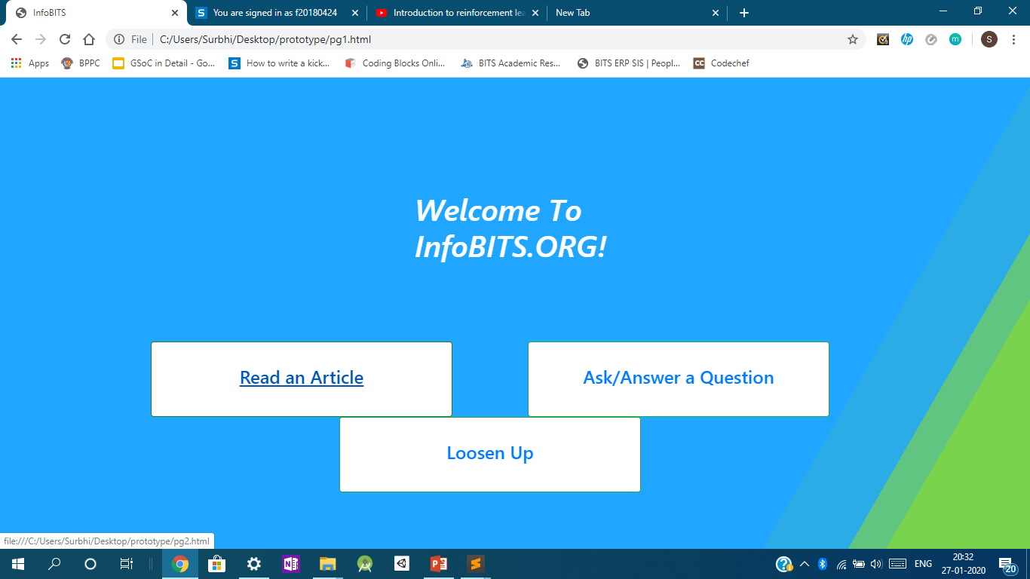


Slide 4
ON CLICKING “Read an article”

Slide 5
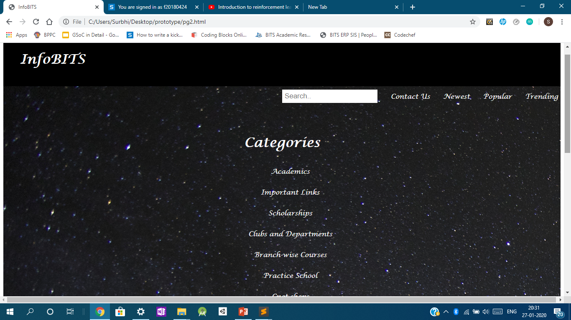

Slide 6
On clicking “ask/answer”

Slide 7
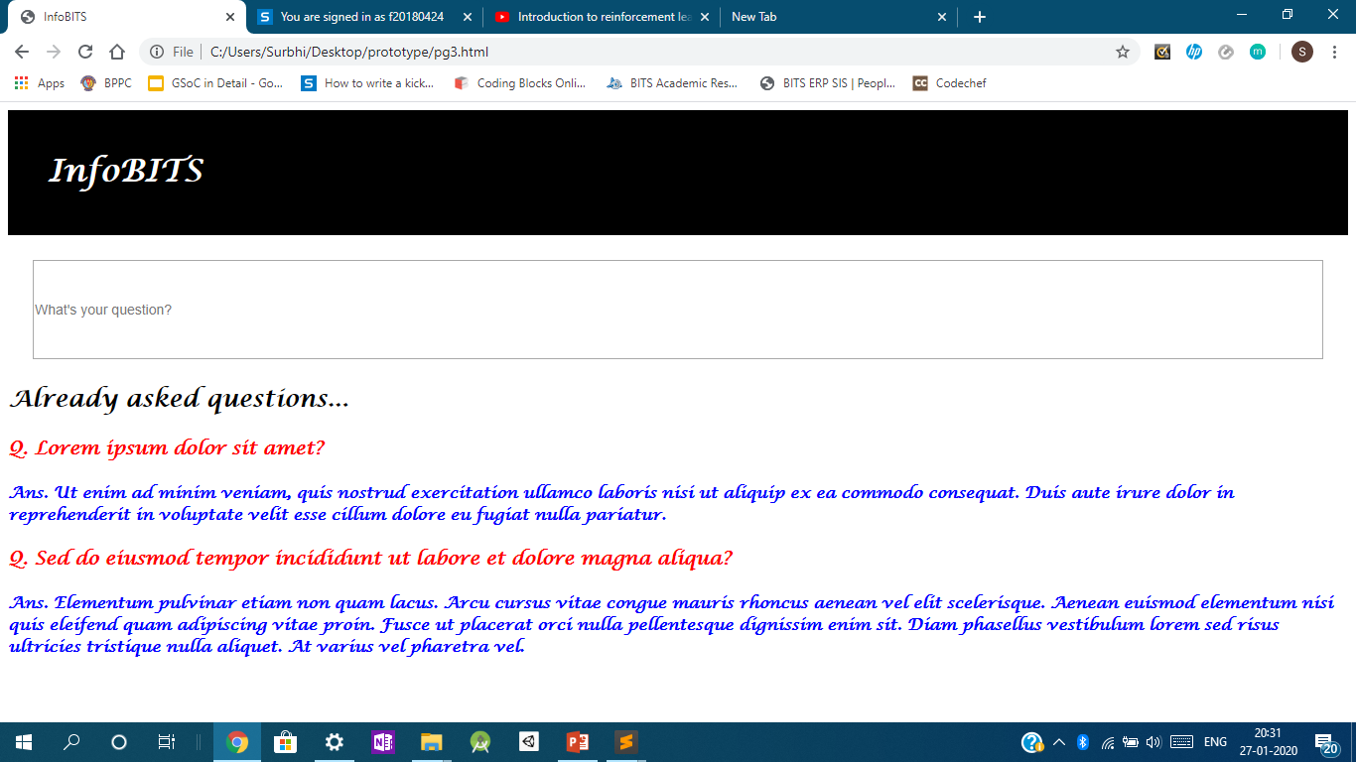

Slide 8
On clicking “loosen up”
‘Loosen Up’ helps students looking for an empty room during class hours in BPPC by giving them a list of the rooms that are free in the various classroom buildings.

Slide 9
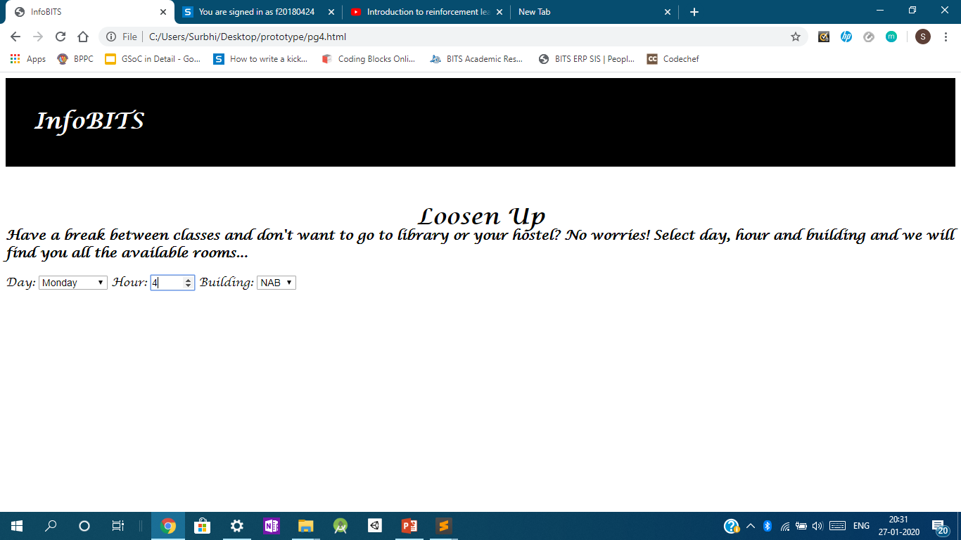

Slide 10
THANK YOU ☺

